Slide 1

BIT111 Introduction to ICT
A Regional University Transcending Boundaries

Slide 2
Introduction To Computers

Slide 3
Definition
A computer: is an electronic device that processes data, into meaningful information that is useful to people.
A Computer: is an electronic device that accepts input, processes it, stores data, and produces output.
A Computer: an advanced electronic device that accepts input, processes it, stores data, and produces output.

Slide 4
Basic Functions Of A Computer
Accepts data (input): Receives data from outside(input device) for processing.
Process data (Processing): Performs operations or manipulations on data particularly numerical data.
Produce output (output) Produces data from within for external use.
Stores results (Storage): Holds data internally before, during and after processing. Hard disks, CD-ROM, DVD ROM, Tapes and others.

Slide 5
Computer System
Set of interrelated elements working together in an integrated away to achieve a set of objectives.
It consist of
Hardware: computer itself and any equipment connected to it (tangible/physical components) that make up a computer system.
Software: set of instruction that the computer follows in performing a task. Or is a series of instructions that tell a computer how to carry out a processing task.
Data: facts that are used by program to produce useful information
Procedures: policies that govern the operation of a computer system
People: every computer needs people if its to be useful.

Slide 6
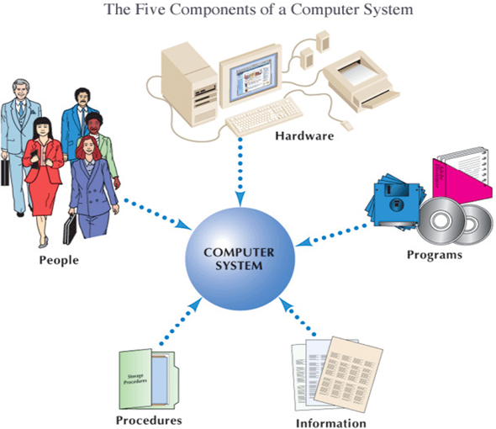
5 Components of a Computer System

Slide 7
Advantage of computers
Speed: Computers work at very high speeds and are much faster than humans. Computer speed is measured in Mega Hertz (MHz).
Storage: A computer can store a large amount of data permanently. User can use this data at any time. Text, graphic, pictures, audio and video files can be stored easily.
Processing: A computer can process the given instructions. It can perform different types of processing like addition, subtraction, multiplication and division. It can also perform logical functions like comparing two numbers to decide which one is the bigger etc.
Accuracy: Provide results without any error. Computers can process large amount of data and generate error-free results.

Slide 8
Advantage of computers
Communication: Most computers today have the capability of communicating with other computers. We can connect two or more computers by a communication device such as modem.
Versatility: Computers can do computations with all kinds of data including alphabets, pictures, sound images, voice, e.t.c.
Automation: Computers work automatically, i.e. they do not need any supervision to do programmed routines.
Diligence: Computers are diligent i.e. they have ability to perform the same task “over and over” without getting tired e.g. in industrial robotics, like those in Car assembly lines.
Artificial Intelligence: Computers can respond to requests given to them and provide solutions.

Slide 9
Disadvantage Of Computers
Create unemployment
Health problems
Expensive
Laziness
Sources of computer viruses
Crackers
Delicate
Literate people
Immoral activities
Technology changes

Slide 10
Limitation Of Computers
Vuln
Have no common sense
Need power in order to operate
Technology change very often
Computers are delicate

Slide 11
Uses of Computers
Personal and Home
Computers allow people with disabilities to do normal activities.
Shopping online
Playing games with other people
Work from home
Entertainment such as listening to music, watching videos etc.
Enable communication through the use of (electronic mails) e-mails , chats etc.

Slide 12
Business Uses of Computers
Computers allow companies to keep large amounts of information at hand by using databases
Makes ordering and tracking resources quicker and easier.
Allows people to have meetings from different locations.
Helps in information management which eases the process of decision making .

Slide 13
Educational Uses of Computers
The Internet allows access to hundreds of online research materials.
Allows colleagues to correspond quickly about ongoing research.
Eases the process of analyzing research data.

Slide 14
Data and Information
Data is a collection of raw and unprocessed facts, figures, numbers, characters, images and symbols.
Information is data that is organized, meaningful and useful. The process of transforming data (facts) into information is called data processing.
Data is presented in the form that a computer understands (binary digits 0/1).
A string of 8 bits a called a byte which represent a character.

Slide 15
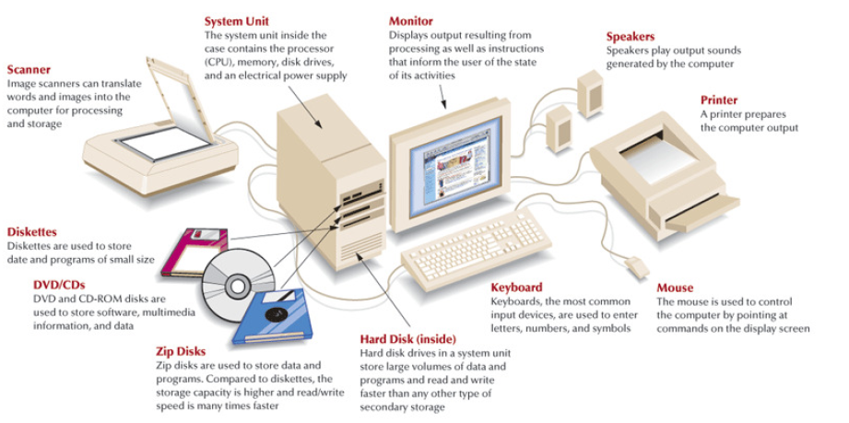
Computer Hardware

Slide 16
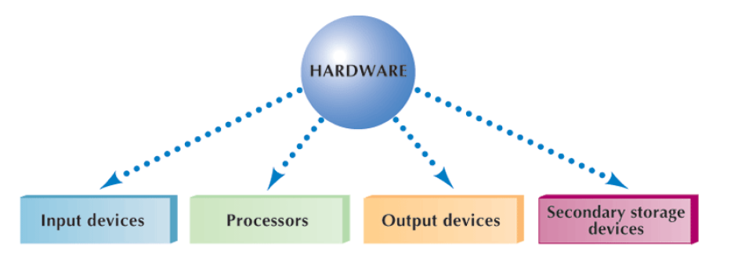
Categories of hardware

Slide 17
Input Devices
Input: The data or information entered into a computer
The process of entering data/information into the computer for processing, storage and retrieval, or transmission.
Example of input devices
Keyboards
Mouse
Touch screen
Digital camera
Scanner
Point of sale terminals
Bar code reader
Microphones
prerecorded sources lie CD & DVS
Notes:
Input devices e.g Camera’s used to take pictures during voter registration

Slide 18
Output Devices
Output: The results of inputting and processing data and information returned by the computer, either directly to the person using the system or to secondary storage.
Common forms of output are reports, schedules, budgets, newsletter s among others. Examples of output devices include:
Printers
Plotters (prints large images (plan))
Speakers
Monitor
Projectors
Note: Communications devices (such as modems and network interface cards) perform both input and output, allowing computers to share information.

Slide 19
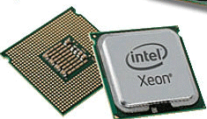
Processor (CPU)
Processor/Central Processing Unit (CPU): A set of electronic circuits that perform the computer’s processing actions.
A chip is a collection of electronic components in a very small, self-contained package. Chips perform the computer’s processing actions, including arithmetic calculations and the generation of lines, images, and sound.
Examples of chips include sound chips which
generate signals to be output as tones.

Slide 20
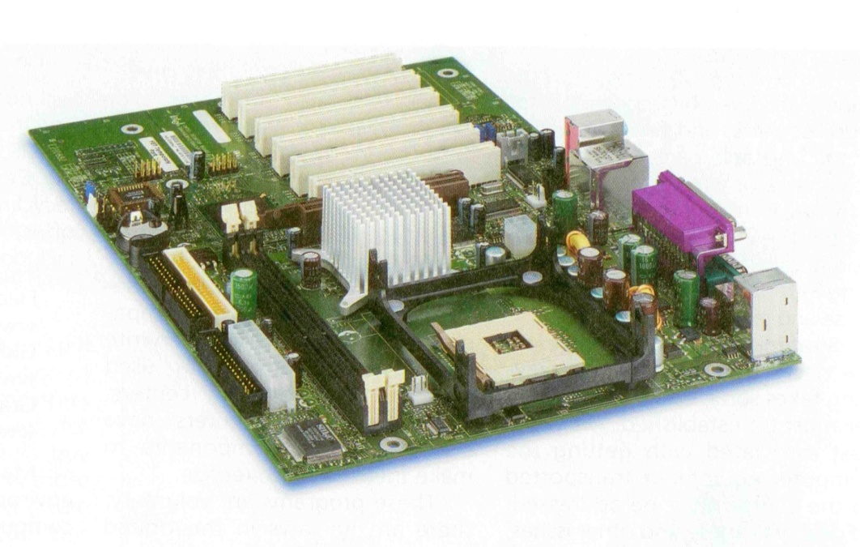
System board
The processor/CPU can take several forms. Microcomputers contain a specific micro-processor chip as their CPU. This is put into a protective package, and then mounted onto a board contained within the computer. This board is called a system board or a mother board.
The system board contains other chips and circuitry that carry out processing.

Slide 21
Hardware cont’d
Memory devices
Memory is made up of one or more sets of chips that Store data or program instructions either temporarily or permanently. No processing takes place in memory. Instead, memory stores data, information and instructions. Memory is divided into two types:
Random Access Memory (RAM)
RAM holds data and program instructions temporarily while the CPU works with them.
RAM is volatile, meaning it holds data only when the power is on. When the power is off, RAM's contents are lost.
More RAM results in a faster system.

Slide 22
Hardware cont’d
Read Only Memory (ROM)
Permanent storage of programs.
ROM is called non-volatile memory because it never loses its contents.
Holds instructions that the computer needs to operate.
This type of memory lets you store the data needed to start up or boot the computer
Essential start-up data contained in ROM is a computer BIOS
The BIOS includes instructions on how to load basic computer hardware and includes a test referred to as a POST (Power On Self Test) that helps verify the computer meets requirements to boot up properly.

Slide 23
Hardware cont’d
Read Only Memory (ROM)
Permanent storage of programs.
ROM is called non-volatile memory because it never loses its contents.
Holds instructions that the computer needs to operate.
Memory is measured in terms of:
Kilobyte (KB) - 1,000 bytes
Megabyte (MB) - 1,000,000 bytes
Gigabyte (GB) - 1,000,000,000 bytes
Terabyte (TB) - 1,000,000,000,000 bytes.

Slide 24
Bits and Bytes
1 Bit is a single 0 or 1.
1 Byte consists of 8 bits.
1 Kilobyte consists of 1,024 bytes approximately 1000 bytes.
One Megabyte is 1,024 kilobytes or approximately million bytes.
1 Gigabyte is 1,024 megabytes or approximately 1 billion bytes
1 Terabyte is 1,024 gigabytes or approximately 1 trillion bytes.

Slide 25
Storage Devices
The purpose of storage is to hold data permanently, even when the computer is turned off.
Storage devices hold data not currently being used by the CPU.
Data is commonly stored on a magnetic or optical disk.
A disk drive is a device that reads data from and writes data to a disk. Most new computers feature a floppy disk drive, a hard disk drive, and an optical disk drive.
The most common optical storage devices are CDROM and DVD-ROM drives.

Slide 26
Computer Health and Safety issues
Never user the computer in a dusty environment
Water should be avoided near computers
Never eat or drink in a computer room
Do not smoke near computers
Do not block the ventilation hole on a computer when its hot
Computer room must be well ventilated
Do not allow diskettes from outside (viruses)
Do not switch the computer on and off abruptly
Protect the machine using UPS and stabilizers
When in doubt. Please ask an expert.

Slide 27
Classification of Computers
Computers are classified according to;
Size: Some computers are designed for individual use while others are for organizations.
Technology: Some computers are more powerful than others in terms of the speed at which they operate as well as the technologies they use.
Purpose: Some computers are designed to handle lighter tasks compared to others that can handle heavier tasks
Because of the above factors, we have computers of different prices, having different hardware as well as compatible with different software.

Slide 28
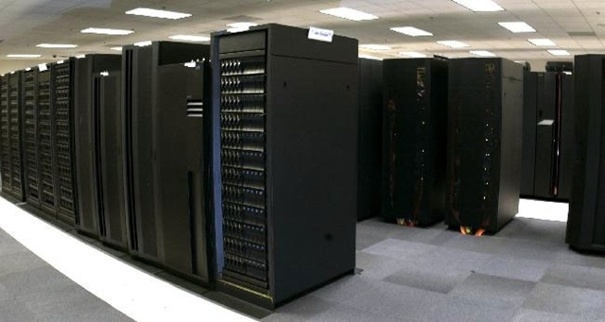
Classification of Computers According to size
Supercomputers
The most powerful computers made.
Handle large and complex calculations.
Because of their size and expense, supercomputers are relatively rare.
These are used by research institutions, government agencies, and large businesses.
.

Slide 29
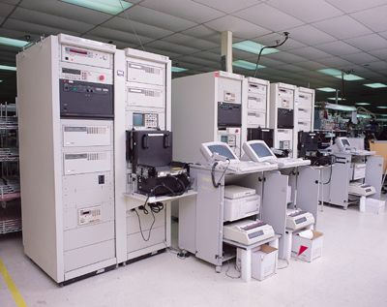
Classification of Computers According to size
Mainframe Computers
Are slower, less powerful and less expensive than supercomputers.
Are used by banks and many businesses to update inventory etc.
Are used in large organizations where many users need access to shared data and programs.
Can support thousands of users, handling massive amounts of input, output, and storage.

Slide 30
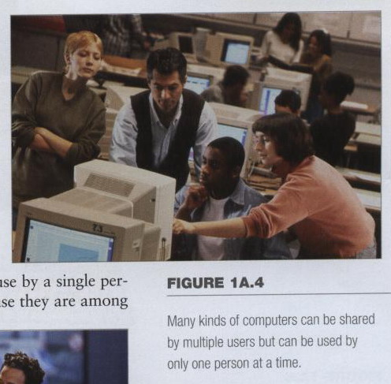
Micro computers/Personal Computers
Computers can be shared by multiple users but can be used by only one person at a time.
Types of computers in this category
include;
- Desktop computers
- Workstations
- Notebooks
- Tablet computers
- Handheld Computers
- Smart phones

Slide 31
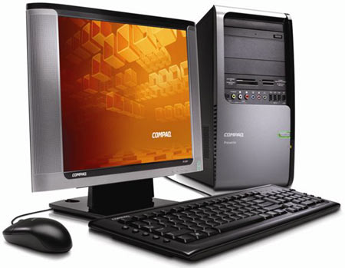
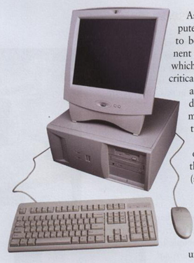
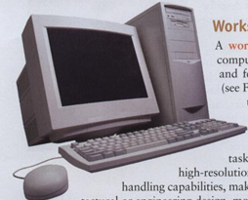
Microcomputers
Desktop computers
The most common type of computer
Sits on the desk or floor
Performs a variety of tasks including producing music, edit photographs and videos, play sophisticated games and videos

Slide 32
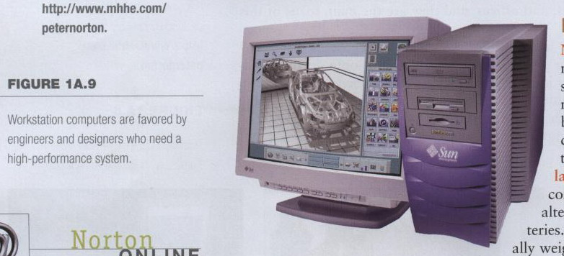
Microcomputers
Workstations
Has more power and features than a standard desktop PC
Have large, high resolution monitors
Suitable for architectural engineering design, animation and video editing.

Slide 33
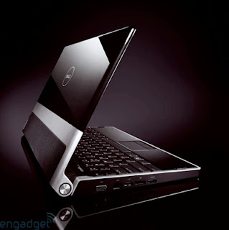
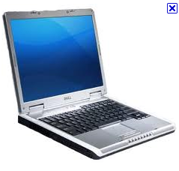
Microcomputers
Notebook computers/ Laptops
Small portable computers
Weighs between 3 and 8 pounds
People frequently set these devices on their laps hence laptop computers
Operate on alternating current or special batteries
When not in use, device folds up for easy storage.
Notes:
Discussion point
Have students contrast desktop and notebook computers. Focus on the pros and cons of each type of computer.

Slide 34
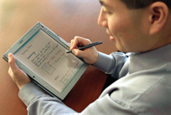
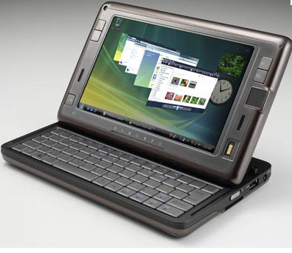
Microcomputers
Tablet computers
One of the new development in portable computers
Input is through a pen
Run specialized versions of office products
Notes:
tip
The tablet PC was designed to simulate a piece of paper. Users interact with the tablet as if it was an unlimited paper notebook.
For more information
See www.microsoft.com/windowsxp/tabletpc/evaluation/tours/default.mspx for an example of the Tablet PC in action.

Slide 35
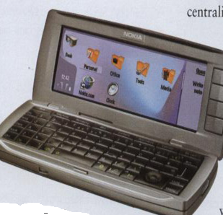
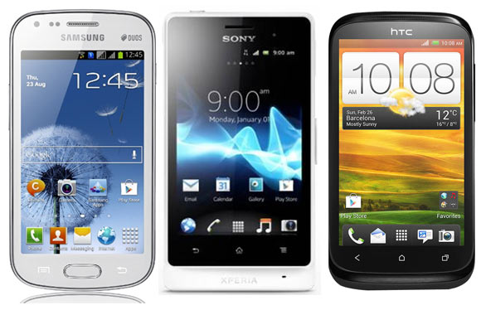
Microcomputers
Smart phones
Hybrid of
cell phone
and Personal Digital Assistants (PDAs)
Web surfing,
e-mail access

Slide 36
Common Terms
Program: set of computer instructions that enable the computer hardware to accomplish a task.
Application: a program in which you do your work
Driver: a file on a computer which tells it how to communicate with an add-on piece of equipment. E.g. sound drivers, network drivers etc.`
Software: set of instructions that the computer follow in performing a task.
Data processing: process where data is transformed into information.
Information Communication Technology (ICT): Scientific mean of sending and receiving information which requires sending understanding and sending feedback

